Slide 1
MEKELLE INSTITUTE Of TECHNOLOGY (MIT) Building Material Management System Assignment Explanation
Name ID
1. Tsegay Welu mit/ur/207/09
2. Tswa Teklu mit/ur/068/09

Slide 2
Building Material Management System Assignment how we done ?
For our assignment we made many efforts to understand the possible requirements and to now how the system works. We made interview with the following building materials sellers
1,seyfu building material seller at romanat adebabay mekelle city
2,yohannes building material seller at endaselasie
3,tigabu building material seller at aynalem
But it was difficult to us to understand how the system works because in our country there is poor technology dovelopment and users did not know what they want.

Slide 3
Building Material Management System what is the user types?
In our assignment we have four type of users
1,administrators
2,custemers
3,suppliers
4,tax preparers
And each of the user types have their own work.

Slide 4
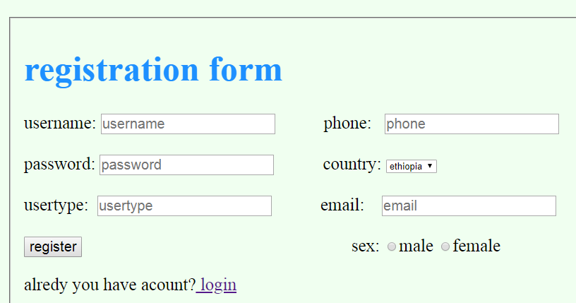
Building Material Management System registration form

Slide 5
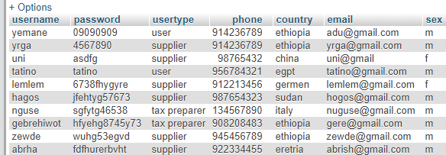
Building Material Management System registration form
As we have seen the system registers customer and supplier
And then their data will be
Inserted to the database
Build and Table name
Is register.

Slide 6
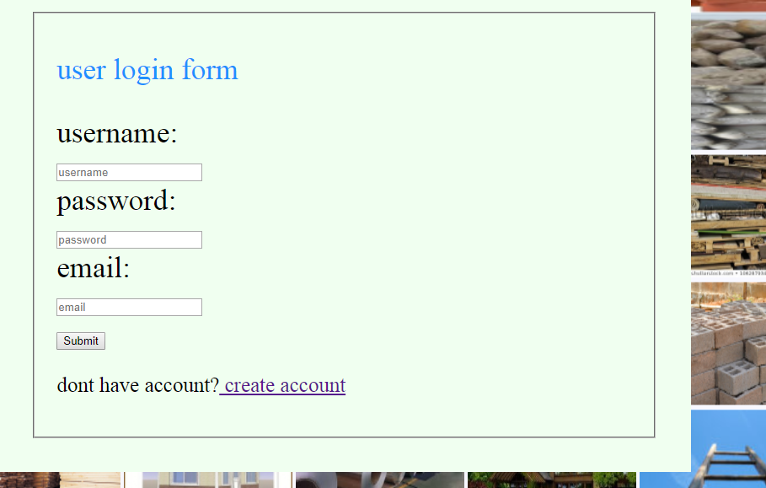
Building Material Management System login page

Slide 7
Building Material Management System login page
in this how the system work is it fetches username, password and email from table register and checks with the inserted
username, password and email by the user
And then if they match user can login to home.

Slide 8
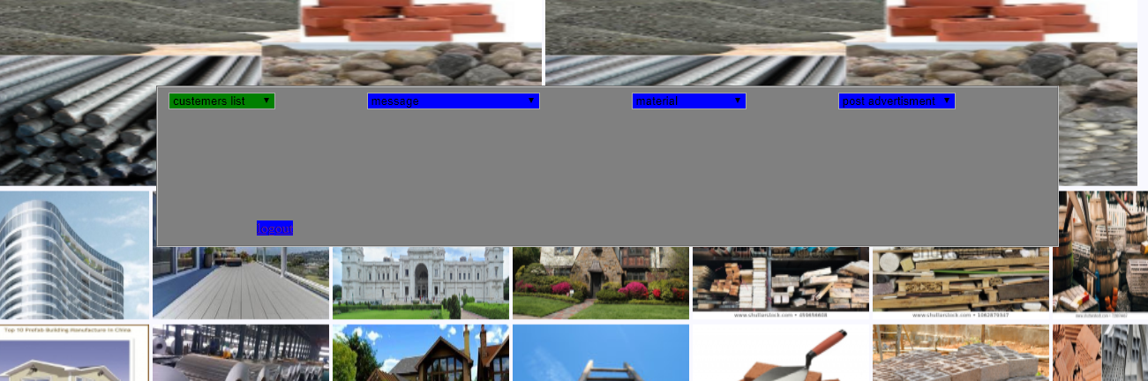
Building Material Management System administrator can do
In the system administrator can do
1,see customer list
2,delet account of customer
3, block account of customer

Slide 9
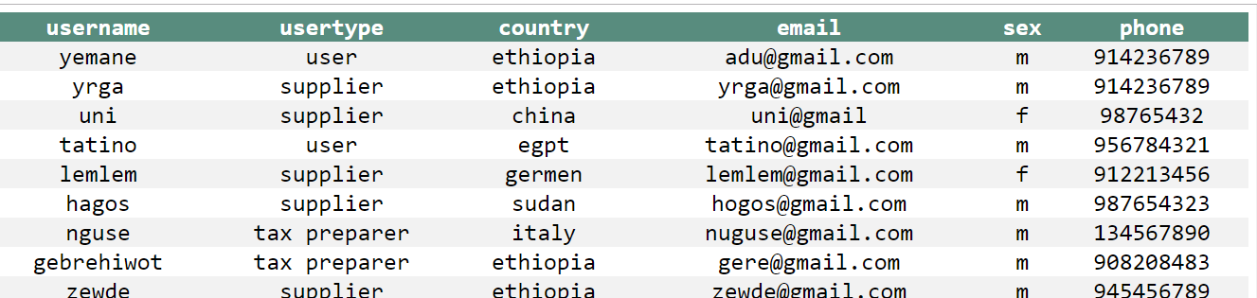
Building Material Management System administrator can do
4,post advertisement
5,update advertisement
6,see material list
7,see seled material list
8,read massage from user.
9,send message for each customer through their email
10,calculate its profit
11,reads supplier advertisement

Slide 10
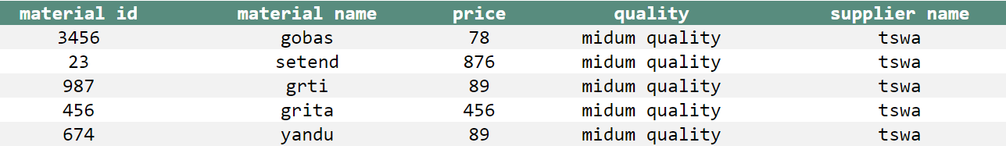
administrator reading selled material lists

Slide 11
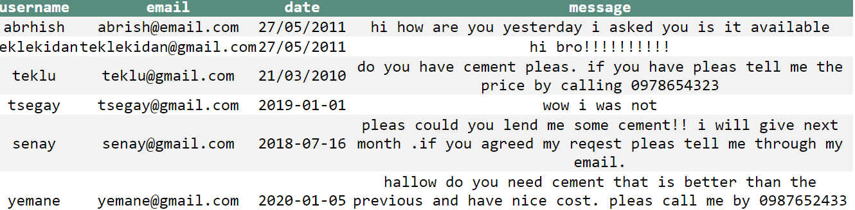
administrator reading users massage

Slide 12
Building Material Management System user can do
1,read advertisement of admin
2,write any compliant to admin
3,buy material
4,read material list
5,log out

Slide 13
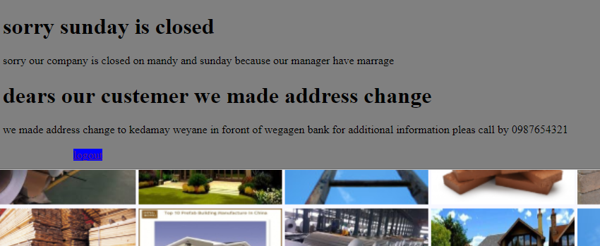
User reading advertisement of admin

Slide 14
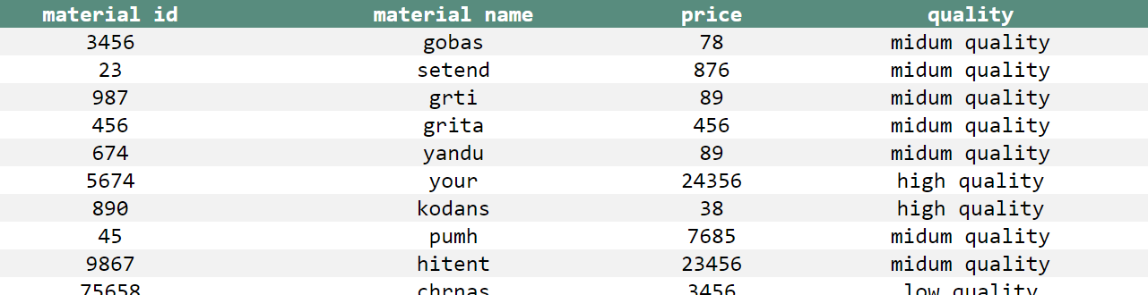
User reading list of materials

Slide 15
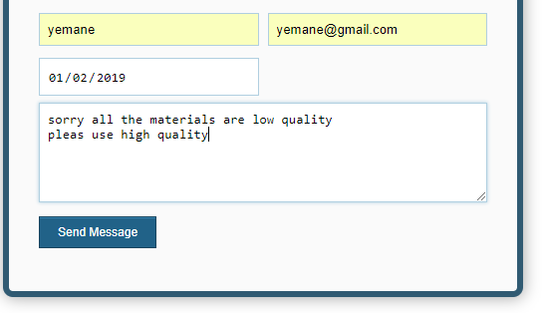
User writing complaint to admin

Slide 16
Building Material Management System supplier can do
1,supply materials
2,write massage to specific users
3,read advertisement of admin
5,read material list
6,logout

Slide 17
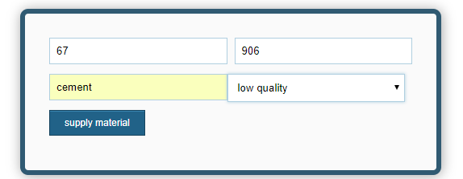
Supplier supplying materials

Slide 18
10Q THE END

